Slide 1


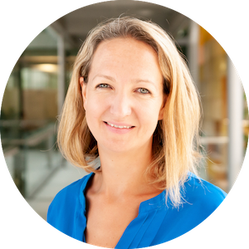
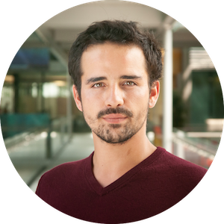
Welcome to the EPFL Extension School
Let’s go for a tour!
Your hosts: Kate & Rémi

Slide 2
Before we start…
This session is a discovery webinar for individuals and partners considering a digital upskilling initiative
We aim to complete the session in 45 minutes
This session will be recorded for participants who need to leave early or who could not attend the session
We will take questions at the end of the session
You can use the chat to leave comments and questions throughout the discussion
You will receive access to a dedicated landing page where you can find all the content after the webinar

Slide 3
Discover what’s happening behind the scenes!
Why digital skills matter for everyone
What you can expect from an EPFL Extension School experience
How you can acquire digital knowledge and skills
Who are your support team
Live demo of our learner platform
Q&A

Slide 4
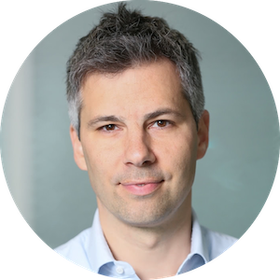
Meet Marcel Salathé,
our Founder & Academic Director

Slide 5



Why are digital skills so important for everyone?
Take control of your digital work space. Interact with other stakeholders about digital topics and ask the right questions.
Take your seat at the table by learning to communicate and collaborate effectively with all digital stakeholders.
Develop new products and applications thus ensuring your competitive edge.
Confidence
Collaboration
Contribution

Slide 6



What do we mean by “everyone”?
Our courses are accessible to everyone no matter your….
Age
From teenagers to retirees
Education
From apprenticeships to PhDs
Occupation
From students to parents, from marketers to scientists and everything in between
Notes:
run poll 1 after this slide

Slide 7











What you can expect from an EPFL Extension School learning experience
Quality
Flexibility
Hands-on
Support
EPFL education
100% online
Projects & coursework
EPFL Instructors
EPFL COS diploma
Self paced
Capstone project
One-to-one support

Slide 8
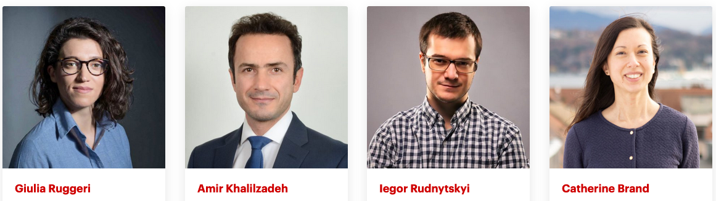
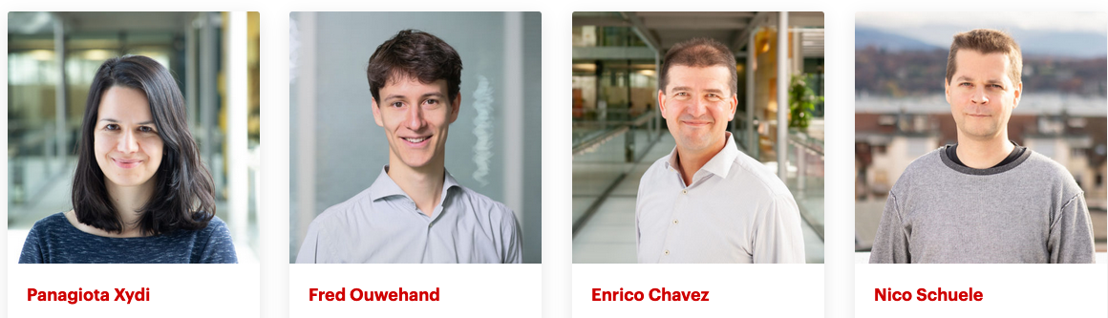
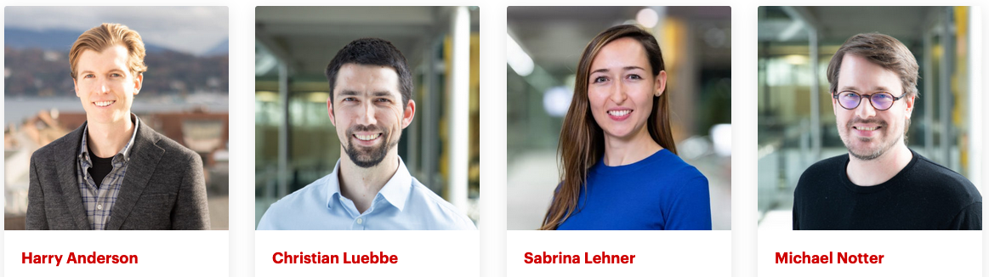
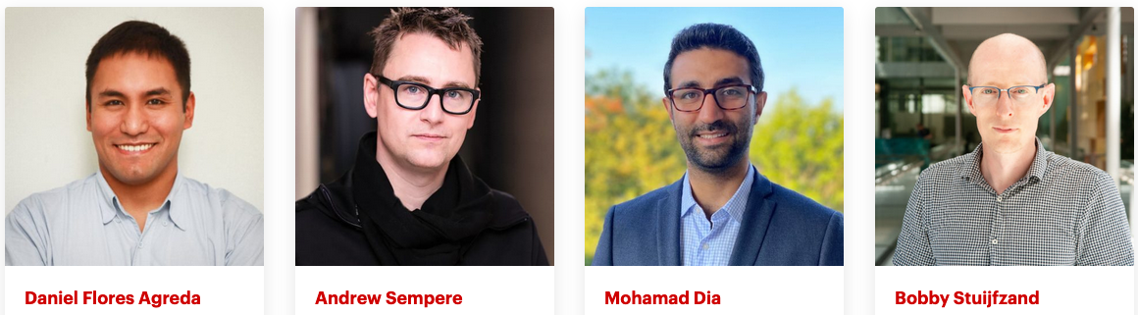
Your Course Instructors
Dedicated to sharing their passion for digital & data literacy and professional skill building

Slide 9
We accompany you from the discovery of knowledge to the deepening of the most sought-after skills.
Which course is the right for me?

Slide 10
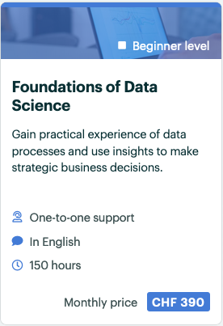
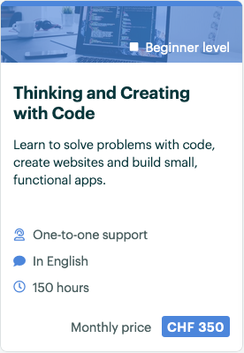
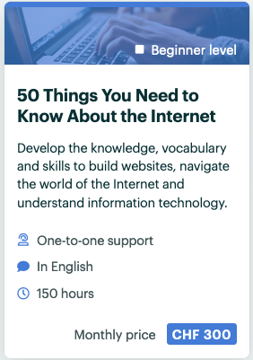
Develop
Integrate digital literacy into your work
Acquire the following business-ready skills:
data analysis capabilities
effective IT project management
process automation

Slide 11
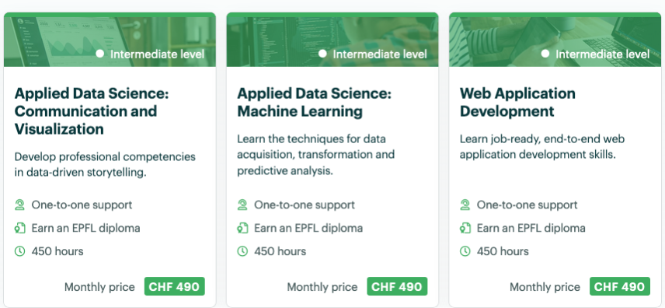
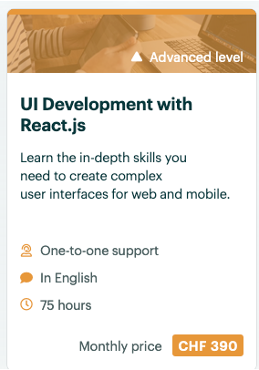
Deepen
Develop products and applications and explore new technologies
Acquire the following business-ready skills:
advanced project management
machine learning toolkit and advanced AI products
new web applications, interactive apps and interfaces

Slide 12
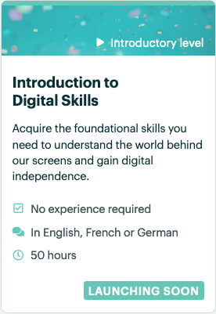

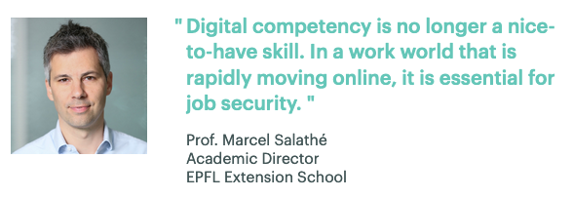
New course launching early 2021
Introduction to Digital Skills
Acquire the following business-ready skills:
technical independence
communicate effectively with other digital stakeholders
best practices for privacy and security
Available in English, French and German
Notes:
run poll 2 after this slide

Slide 13
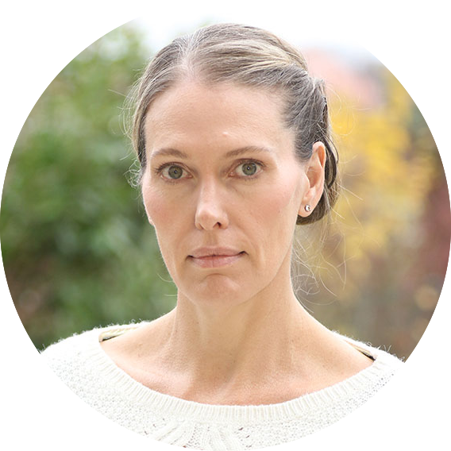
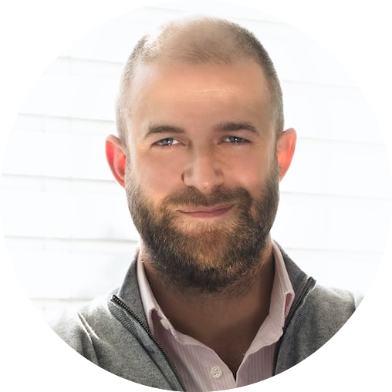
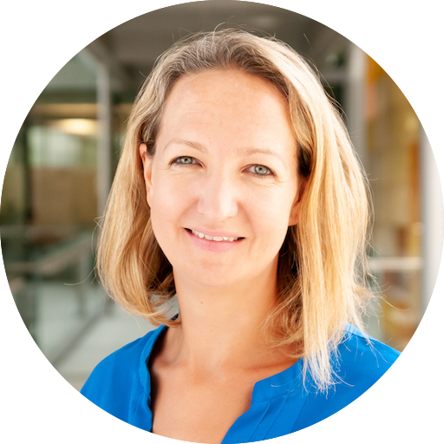
Your Learner Experience Managers
Here to ensure you get the most out your learning experience
Deliver a smooth and engaging onboarding experience
Define targets, monitor progress and propose regular check-ins
Ensure our learners feels cared-for, stay engaged and motivated
Organize events and webinars
Propose networking opportunities and “learning buddies”
Provide access to an engaging alumni community

Slide 14
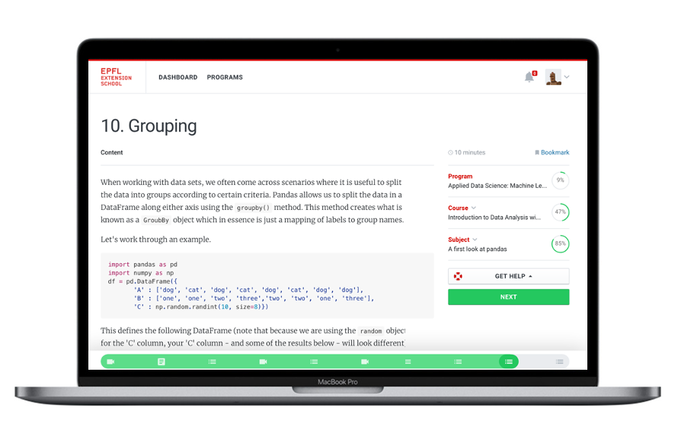
Our proprietary learning platform
Join us for a tour!
Custom built by our in-house development team
EPFL-owned
Compliant with GDPR and Swiss privacy regulations
Designed for a simple yet effective user experience

Slide 15


What’s next?
Visit your dedicated landing page
Contact your Learner Managers if you have more questions
Create your account and start learning at anytime
learner.support@extensionschool.ch

Slide 16
Do you have any questions for us?

Slide 17
Thank you for your attention.
Your hosts: Kate & Rémi
Contact & visit us
learner.support@extensionschool.ch
extensionschool.ch

